Slide 1
Git and GitHub
Git –Distributed version control system
It is a tool
GitHub-GitHub is a hosting service
It is a service

Slide 2
AGENDA:
Understand version control system.
What is Distributed version control system?
What is Git?
What is Github?
Install and Run Git on your local machine.
How to work on Github?
What is repository? How to create a repository.
Add, commit, push, pull commands
Create Branching
Raising pull request
Approve pull request
Merging.

Slide 3
What is Version Control System?
Version control is a system that records changes to a file or set of files over the time so that you can recall specific version later
These versions are recorded in a repository and can be recalled from the same.
There are three type of version control systems
Local version control system
Centralized version control system
Distributed version control system

Slide 4
1. Local Version Control System-
In local version control system all the code or all the changes will track on local system.
Server
Developer 1

Slide 5
2. Centralized Version Control System-
In centralized version control system developers are connected to the centralized server. They can update there code or collaborate with each other
Server
Developer 2
Developer 3
Developer 1

Slide 6
3. Distributed Version Control System-
In Distributed version control system each developer have there own local copy of repository which they can further collaborate with other developers by merging them or pushing them.
Server
Push
Pull
Pull
Push
Pull
Push
Local repository
(git)
Local repository
(git)
Local repository
(git)
Working
area
Working
area
Working
area
Developer 1
Developer 2
Developer 3

Slide 7
Why do we need version control system?
Manage versions-All versions of code are preserved.
Rollbacks-Easy rollback from current version.
For better collaboration-shared workspace and real-time updates.
Reduce Downtime- Reverse faulty update and save time.
Analyze project- analyze or compare projects.

Slide 8
Difference between centralized and Distributed version control system-
Centralized version control system-
In centralized version control system we have a centralized server. So update and commit the code directly to the serve
2. Distributed version control system-
In Distributed version control system each developer have there own local copy of repository which they can further collaborate with other developers by merging them or pushing them.

Slide 9
What is Repository?
A Repository is a directory or storage space where your projects can live.
It can be local to a folder on your computer or it can be storage space on another online host(such as GitHub)
You can keep code files, text files, image files you name it inside a repository.
GitHub is a very popular central repository that allows you to share your files.

Slide 10
Git-Distributed version control system
Git is a distributed version control system used to track changes in computer files. It’s a tool to manage your code and file history while coordinating
It’s a tool to manage your code and file history.
It lets you and your team of developers work together on the same project from anywhere. Team members can work on files and easily merge their changes into one source.
checkout
Working
directory
Staging
area
Local
.git
Remote Repository
(GitHub)
push
add
commit
fetch
pull

Slide 11
Features of Git-
It is free and open source.
Supports non-linear development of software(parallel development)
Records changes made to a file rather than file itself.
Distributed- Every user has his own copy of the repository data stored locally
Speed- speed offered by Git is lightening fast compared to other vcs.
Robustness- Nearly every task in Git is undo-able
Integrity
Branching
No need of powerful hardware
Security

Slide 12
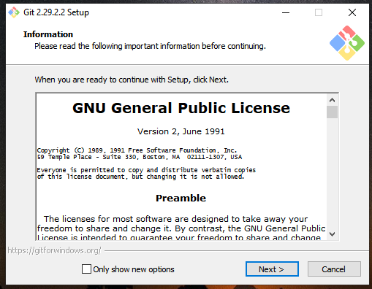
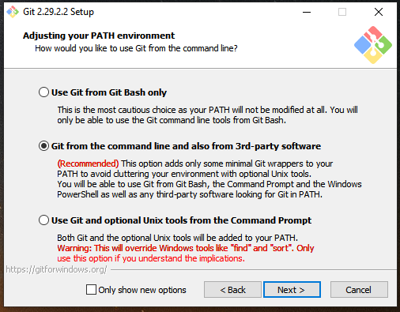
How to install Git on your local machine:

Slide 14
GitHub-
GitHub is a hosting service for git repositories. Git is the tool while GitHub is the service to use git.
GitHub is a remote Repository
GitHub is core hosting & open-source software for version control.
Effective collaboration.
Bug tracker
There are different service providers available who can allow to host your project on remote & have additional features.
GitLab , GitHub, BitBucket

Slide 15
Difference Between Git & GitHub:
1. Git is a Distributed version control system. A tool to manage your source code history. | 1. GitHub is a hosting service for Git repositories.
2. Installed & maintained in your local system. | 2. Exclusively cloud-based.
3. Git –it is a tool | 3. GitHub is the service for projects that use Git

Slide 16
The need for GitHub :
Developers need a web/cloud based code hosting platform
Useful for version control.
Enables effective collaboration.
Download projects and files in one go.
Easy evaluation of each other’s work.

Slide 17
Git Commands :
pwd - pwd is used to print the 'present working directory'. It prints the complete path of the current working directory.
git init - Initialized git repository
Clear – to clear screen
git config – this command is used to configure with git. You canset up your name and email address with this command.
git status - The Git status command gives us all the necessary information about the current branch.
Whether the current branch is up to date
Whether there is anything to commit, push or pull
Whether there are files staged, unstaged or untracked
Whether there are files created, modified or deleted

Slide 18
Git Commands :
git add –
When we create, modify or delete a file, these changes will happen in our local and won't be included in the next commit. We need to use the git add command to include the changes of a file(s) into our next commit.
7. Git commit –
we want to save our changes so here we use git commit command. We also need to write a short message to explain what we have developed or changed in the source code.
git add <file>
git commit -m "commit message"

